Slide 1
Graduate School For Psychology Majors
PSYCHOLOGY UNDERGRADUATE Advisors
Terrill Hall 330

Slide 2
What Do You Want To Do?
Do I Need a Graduate Degree?
Degree versus License
Types of Degrees
Research versus Practice
Types of Programs
Accreditation

Slide 3
Do I Need A Graduate Degree?
Myth: I must go to graduate school.
UNT Career Center
  http://careercenter.unt.edu/
  Careers in Psychology Workshop
Free Career Counseling at UNT Counseling and Testing Services
  http://studentaffairs.unt.edu/counseling-testing-services
  940-565-2741

Slide 4
Degree versus License
University: Degree
State: License
License only required for practice
  Ph.D. or Psy.D. → Licensed Psychologist (LP)
  Masters → Licensed Professional Counselor (LPC)
    LMFT, LMSW, LCDC, etc

Slide 5
Which Type of Graduate Degree
Masters
Doctoral
M.S.
M.A.
M.ED.
Psy.D.
Ph.D.

Slide 6
Masters
2-3 years
Practitioner focused
Little financial support
Admits many students
With a masters in psychology or related field (counseling, marriage and family, social work, etc.) you can practice independently as a licensed mental health professional in the state of Texas
  Different laws/rules state to state

Slide 7
Psy.D.
4-5 years
Practitioner focused
Little financial support
Admits many students
Licensed Psychologist

Slide 8
Ph.D.
5-7 years
Practitioner and research focused
  exception:
    experimental and some other programs are strictly research focused
Typically good financial support
Admits few students
Licensed Psychologist

Slide 9
Which One Is Right For Me?
If you are interested I working in academia, then you need a Ph.D.
If you are interested in working in a hospital setting, forensic psychology, psychological or neuropsychological assessment then you will need a doctoral degree: Ph.D. or Psy.D.
If you are interested in doing psychotherapy, then a masters, a Ph.D. or a Psy.D. may be right for you.

Slide 10
Picking And Applying to PSYC Programs

Slide 11
What Types of Programs?
Clinical
Counseling
Health
Experimental
Industrial/ Organizational
Developmental
Behavioral Analysis
Child psychology
Social
Cognitive
Educational
Forensic
Marriage and Family
Learning
Neuropsychology
Neuroscience
Pediatric
School
Choose what interests you and what you would be happy working in possibly for the next 20+ years.
Luckily, psychology areas overlap a lot, so if you are trained in one specialty, you can sometimes switch specialties later on with more education and experience in the new specialty.

Slide 12
Where Do I Apply?
For Ph.D. and Psy.D. programs apply to APA-accredited programs
      http://www.apa.org/ed/accreditation/programs
      Apply to 10-15 programs
For master’s programs
      A bit more complicated because APA doesn’t accredit them
      Look at APA-accredited doctoral programs and see if the department also offers a standalone masters degree (terminal masters)
      CACREP accredits counseling programs, including masters program
          http://www.cacrep.org
      Apply to 4-5 programs

Slide 13

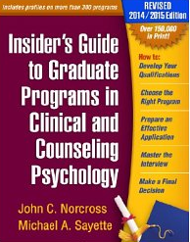
How Do I Find Out About Programs
Program Websites
APA’s Graduate Study in Psychology
Insiders’ Guide to Graduate Programs in Clinical or Counseling Psychology
Connect with faculty and students

Slide 14
Information on Accreditation
Accreditation provides public notification that an institution or program meets standards of quality set forth by an accrediting agency.
Doctoral graduate programs in:
  http://www.apa.org/ed/accreditation/programs/
  Clinical
  Counseling
  School psychology and
  Other developed practice areas
Internship
Licensure
  www.asppb.org
Some agencies only hire folks from APA-accredited programs

Slide 15
Picking a Mentor/Advisor
Pick a mentor/advisor from each school you are applying to and read their publications
Familiarize yourself with what professor does
Send an email: their work is interesting, and curious whether taking new students
Play it by ear
Mentor/Advisor relationship very important for Ph.D. and Psy.D.

Slide 16
Areas to Emphasize
Research
Clinical Experience/Involvement
GPA
Cost

Slide 17
Research
If interested in graduate school, become involved in research early
Complete Quantitative and Experimental Methods ASAP
Become involved in UNT PSYC Research Labs
  More competitive with a higher GPA or previous experience
  Can formally apply during beginning of semester
  Or express interest to faculty member in their research lab
Learn about research labs and faculty research on PSYC Dept website
  https://psychology.unt.edu/faculty
Different faculty members have different requirements and expectations

Slide 18
Research
Join research team
  Procedures
  Special Problems Form on Advising Website
Work hard in lab
  Professor will likely write a letter of recommendation
Try to present poster at conference such as APA or APA
  even if not first author

Slide 19
Clinical Experience, Involvement
Some applied programs like some practical experience
Demonstrates interest and commitment to clinical role
Can volunteer or have a part-time job in a counseling-type role
Volunteer opportunities
      Friends of the Family (www.dcfof.org)
      UNT Volunteer Center (940-565-3021)
      Volunteer Match (www.volunteermatch.org)
Involvement
      Psi Chi
      Leadership opportunities

Slide 20
More Volunteer Opportunities
Suicide and Crisis Center of Dallas
  214.824.7020
Denton County MHMR
  940.565.5282
University Behavioral Health
  940.320.8100
Irving Family Advocacy Center
  972.721.6555
The Nelson Children’s Center
  940.484.8232

Slide 21
GPA
Higher GPA is always better
      Especially in PSYC coursework
Programs vary in their competitiveness and their GPA requirements
All else being equal:
    3.5+ competitive for Ph.D. programs
    3.4+ some Psy.D. or even Ph.D. programs
    3.0+ some masters or even Psy.D. programs
    2.8+ some masters programs

Slide 22
Cost
  Graduate school is very expensive
  In general, masters students don’t get much financial assistance
    Sometimes allowed to teach, research or do office work for pay
  PsyD students don't usually get much assistance either
  PhD students usually get tuition waivers and part-time jobs as research assistants or teaching courses
  Keep in mind the cost of living in your program
    UNT in Denton versus Columbia University in New York City

Slide 23
Graduate School Applications
Curriculum Vitae (CV)
Transcripts
Miscellaneous forms
Personal Statement
GRE scores
Letters of Recommendation

Slide 24
Curriculum Vitae
Academic Resume
Career Center Help

Slide 25
Personal Statement
Plan on spending a lot of time on this essay
  Most difficult 1-2 page essay you’ll write
Stand out, but not overly personal or long
Control your message
Never say “I want to get into psychology because I like to help people”
Let others look it over (graduate students, professors, friends).
Make it at least somewhat personal to each school. You can have a generic outline, but make it individual to every school.

Slide 26
What Personal Statement
What got me interested (psychology and specific area)
  Opening: Original but not ridiculous
  Discussing own issues almost never advised!
What I’ve done so far
  Not CV
  Research (Ph.D.)
  Possibly comment on GPA or GRE
What I’d like to do in the future
  Confident but not egotistical
Fit: Program and mentor/advisor (Ph.D.)

Slide 27
GRE: Graduate Record Examination
Most graduate programs in psychology and related fields will require you to take the GRE
Similar to the SAT
      Verbal
      Math
      Essay
But computer adaptive test and $$$
        $230 to take it, $20 to send to each school beyond first 5
Studying is essential!!!
      Increase comfort with content and structure for best performance

Slide 28
Raise Your GRE Score
Study
Learn directions ahead of time
  Adaptive computerized test
  First 5 questions in each section most important
  Guess rather than skip
Find and study high-frequency word lists
In reading comprehension, read for structure, not details
If problem-solving math question stumps you, work backward from the answers
If a logical reasoning question stumps you, start by finding the conclusion and work backward while examining the premises

Slide 29
Letters of Recommendation
Be careful of who you select!
  Knows you well and will write a strong letter
  Most prestigious
  Psychology instructors preferred
Best to ask in in person
Often graduate students write and the faculty member signs
  Be nice to graduate students

Slide 30
Letters of Recommendation (2)
Give early deadlines
  Give at least 6 weeks notice
Provide EVERYTHING :
  List of all schools and programs
  Clear, brief instructions
  Preaddressed stamped envelopes
  Personal statement
  CV
  Any additional information

Slide 31
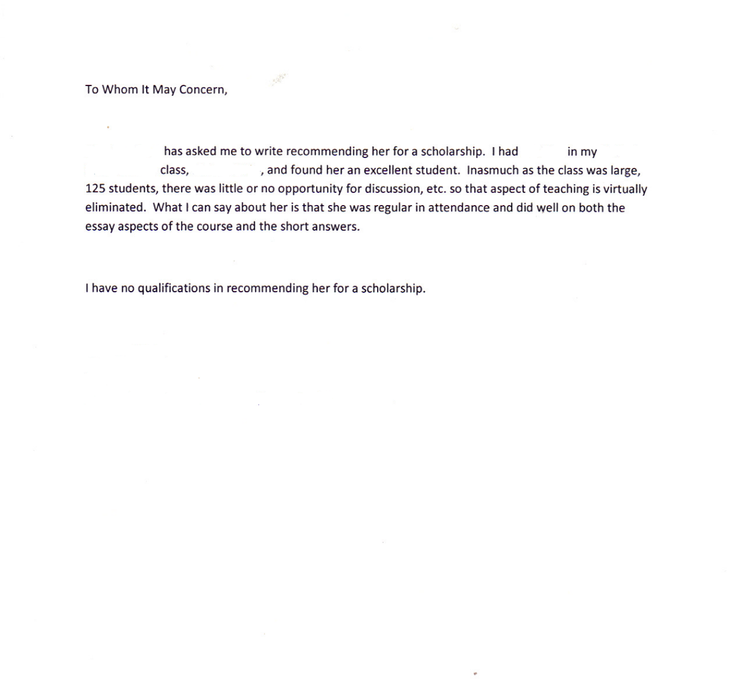
Worst Case Scenario

Slide 32
Timeline

Slide 33
Freshman and Sophomore Year
Finish core PSYC classes (1630, 1650, 2317, 2950)
Maintain high GPA
“Big 4”
  Personality
  Developmental
  Abnormal
  Social
Others
  Physiology
  Learning and Memory
  Perception and Cognition

Slide 34
Freshman and Sophomore (2)
Get to know faculty
  Ask questions in class
  Office hours
  After class
Psi Chi when eligible
  9 PSYC hours
  3.0+ overall and PSYC GPA

Slide 35
Junior Year
If you haven’t already, join a research team
Volunteer
Study for the GRE
Make a list of programs you want to apply to
  see APA’s Graduate Study in Psychology
  Insider’s Guide to Graduate Programs in Clinical or Counseling Psychology or equivalent
Form relationships with faculty

Slide 36
Summer Before Senior Year
Take the GRE
  Can take it again with enough time to send scores by deadlines
Ask professors for letters of recommendation
  Make sure to do this as early as possible
Make final decisions (degree, programs, potential advisors)
Continue doing research
Increase GPA, especially PSYC
Write personal statement
Save money for travel and interviews

Slide 37
Senior Year
Most Ph.D. applications due December-January, with masters applications due right after
Make sure it’s turned in on time
Verify receipt
Keep doing research
  You don’t want to have to explain why you suddenly stopped
Keep doing well in your classes
Go to interviews
Usually notified of acceptance or rejection by April 15
  must accept or reject offer in writing by April 15

Slide 38
Resources

Slide 39
Career Counseling
  Counseling and Testing Services (CTS)
  http://studentaffairs.unt.edu/counseling-testing-services; 940-565-2741
Career Center
  http://studentaffairs.unt.edu/career-center; 940-565-2105
  CV; Mock Interviews; Free Business Cards
The Learning Center
  GRE Preparation Workshops; Online GRE Resources; GRE Study Materials
  http://learningcenter.unt.edu/EntranceAndCertificationExamPrep
Psychology Undergraduate Advising
  TH 330; https://psychology.unt.edu/undergraduate-program/advising

